Slide 1

Agriculture rental machine (Cropease)

Slide 2

I am Balambiga, and I am proud to be a part of a Tester at Cropsease.
I ensure the quality and functionality of our platform, which connects farmers with agricultural machinery for rent.
“Through our work, we help farmers access the resources they need efficiently, supporting agriculture and innovation. I’m excited to share more with you today!"

Slide 3
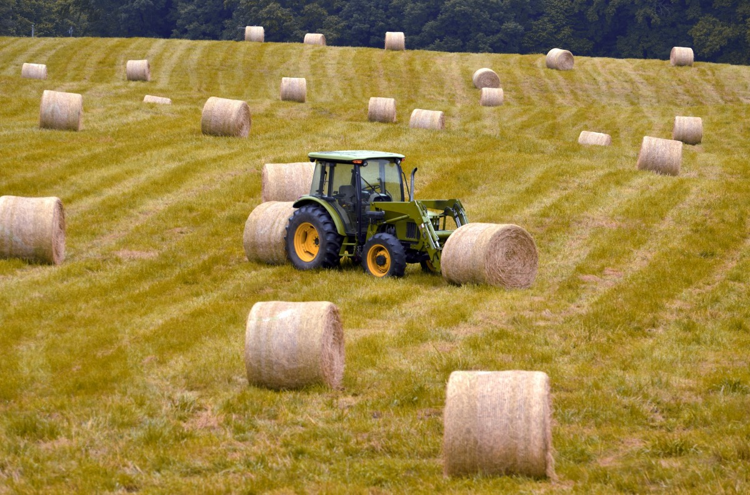
Scope of Testing
My scope of testing that I explored various ways Cropsease helps farmers. I focused on key modules such as machine listing, order confirmation, payment gateway, user registration, and seller registration.
By ensuring the reliability and functionality of these features would help farmers seamlessly access agricultural machinery and streamline the rental process."

Slide 4

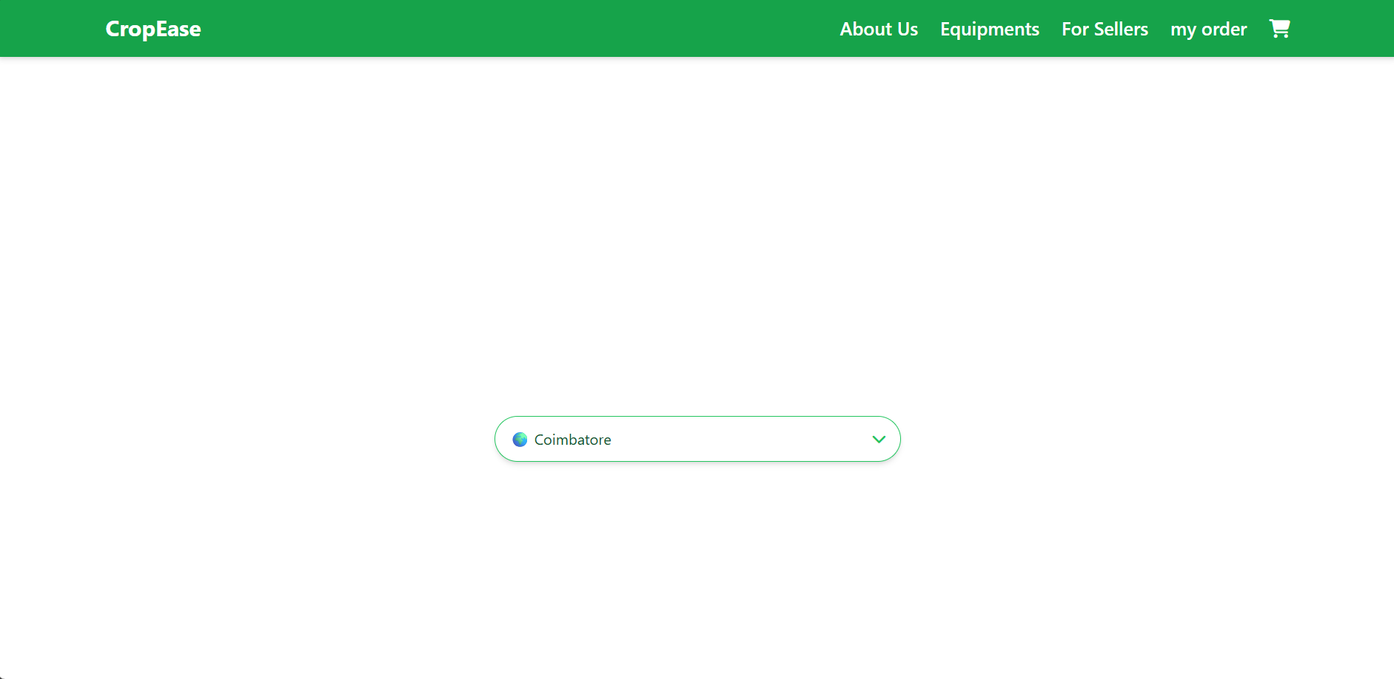

Slide 5
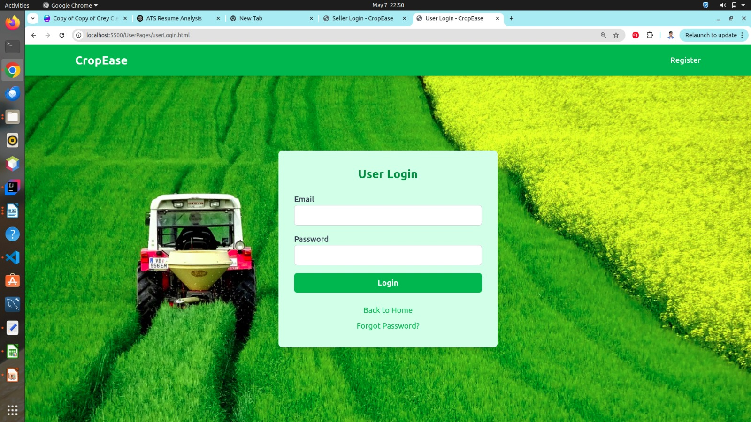

Slide 6

Methodology
My testing approach centers on functional testing, usability testing, and compatibility testing.. This helps create a reliable and efficient experience for farmers and sellers alike.
Artifacts prepared
Test cases
Test scenario
Bug report
Test summary report

Slide 7
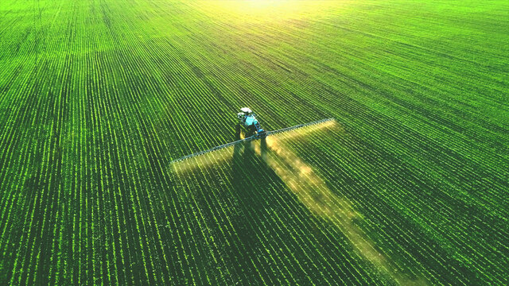
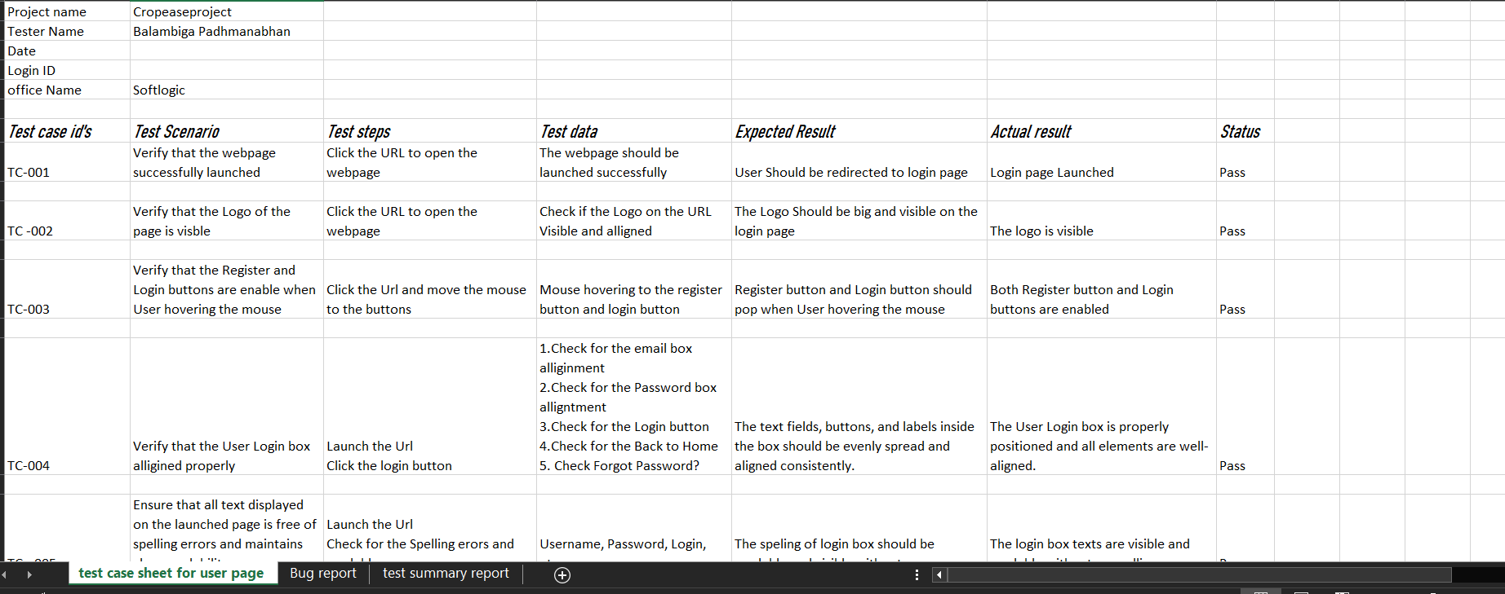
Test cases

Slide 8

Challenges faced
One real-time challenge I encountered was the time lag in background images and machine updates made by sellers.
Additionally, handling payment integration required immediate attention.
These issues were immediately escalated to the development team as a high priority to ensure a seamless experience for users.

Slide 9
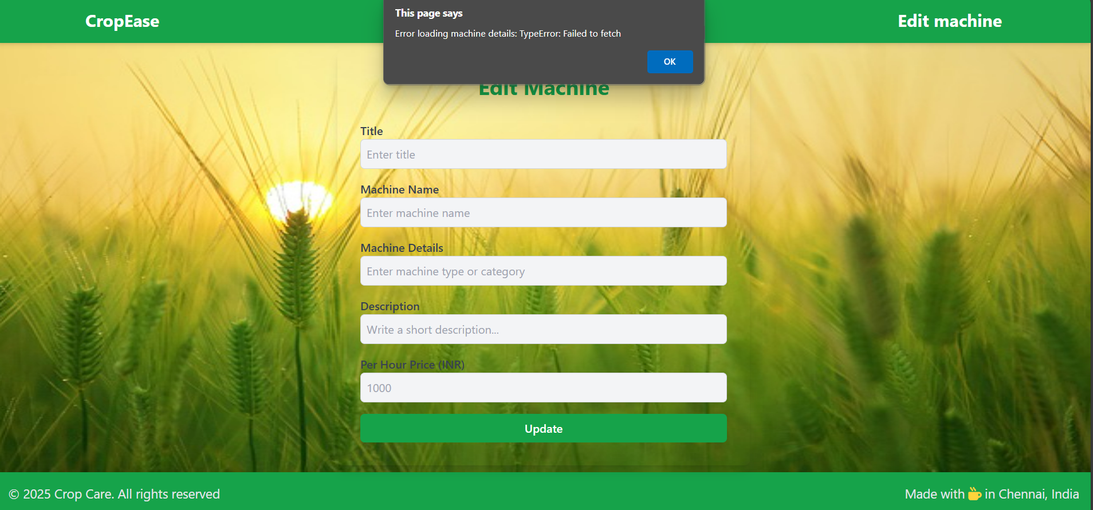
Defect faced

Slide 10
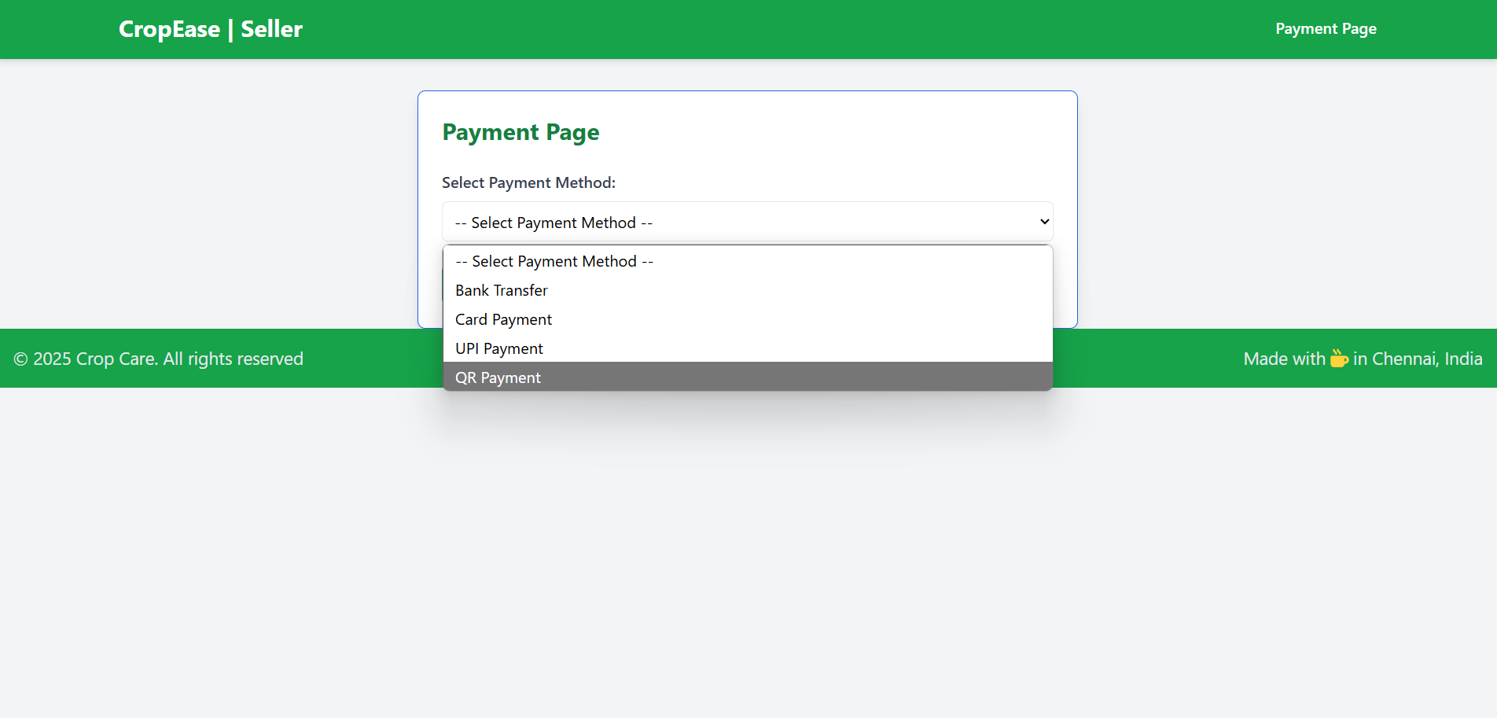

Slide 11

Networking done
I worked closely with the team from the start, which helped them fix bugs quickly.
Result
By the end of testing, I made sure all defects and bugs were fixed, and the platform was running smoothly.

Slide 12
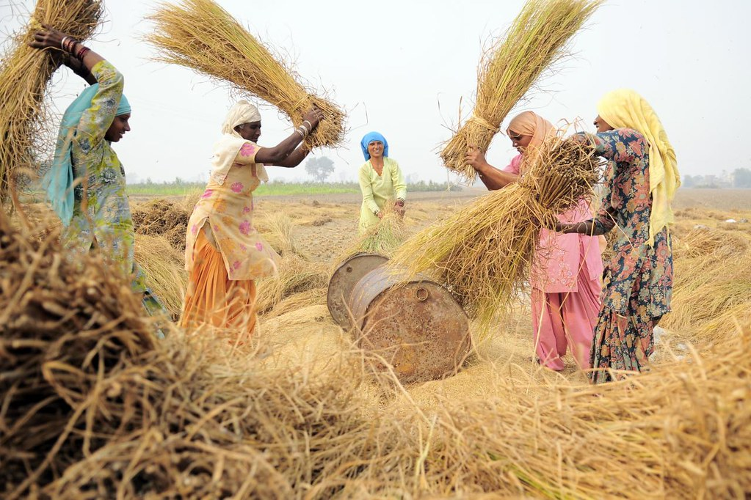
Conclusion
As a tester, I make sure Cropsease works smoothly so farmers can easily access the machinery they need.
This project helped me to learn how to present my work and do manual testing in real situations.

